Slide 1
healthy buildings OF THE FUTURE, TODAY
Notes:
Energy Efficient, Healthy Buildings of the future, today?

Slide 2
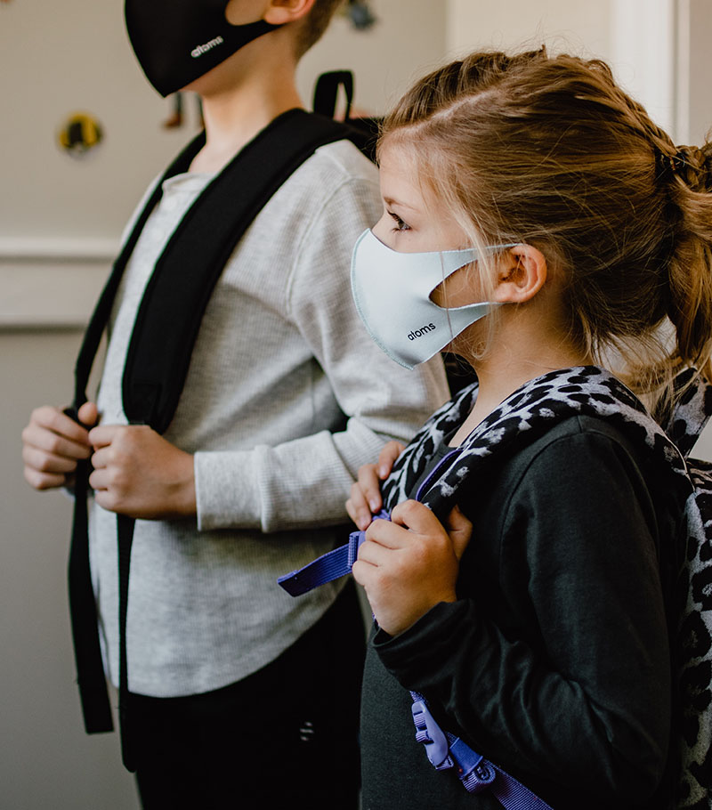
Status Quo: The Problem
Covid & future illnesses disrupt education
Allergies and poor IAQ affect test scores
Funding available, but solutions vary wildly
Simultaneous pressure to decrease energy use
Notes:
Here’s a line that I know you’ve heard a million times: Covid was a huge disruption. The move to remote learning was a massive undertaking, providing kids with laptops, trying to maintain quality of education, etc. And then we brought all the kids back, which had its own challenges. But it was also a wake-up call for poor Indoor Air Quality, both pre and post-covid.
For schools, poor IAQ has direct academic and financial ramifications (test scores, absenteeism). For other industries, the ramifications are reduced productivity, low morale, and of course absenteeism, also. The government stepped in with ESSER funding, and there are grants and other funding sources out there, so schools in particular have been well equipped to invest in things like upgraded filters, purifiers, and other solutions to mitigate poor air quality. Meanwhile, energy-reduction targets seem at odds with adding more, more, more. Better filters make HVAC units work harder. Purifiers use electricity. And the cost of energy rises.

Slide 3
Planned ESSER SPENDINg FY 2023
$9.7 billion
$5 billion
on HVAC Improvements
Additional for facilities
To prevent the spread of COVID-19
To prevent future illness
(https://www.future-ed.org/financial-trends-in-local-schools-covid-aid-spending/)
Notes:
During the 2020-2021 academic year, ESSER spending on physical health and safety accounted for 16.7% of all subgrant expenditures in that reporting period, with Local Education Authorities reporting nearly $2.4 billion in ESSER funds spent on physical health and safety and an additional $18.5 billion planned for this purpose. This category includes COVID mitigation measures, along with longer-term strategies such as upgrading school air quality and ventilation.
For 2023, an analysis of spending plans found that LEAs planned $9.7 billion of expenditures on HVAC improvements to improve indoor air quality, and an additional nearly $5 billion on repairs to facilities to prevent illness.
There’s an old joke about government spending – a billion here, a billion there, pretty soon you’re talking about real money!

Slide 4
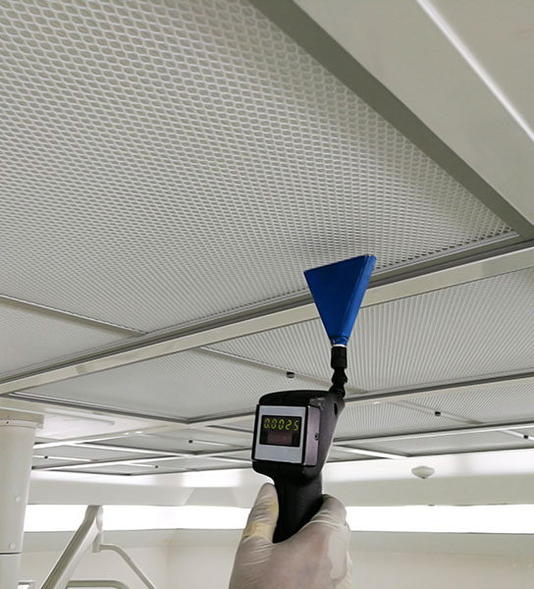
THE PROBLEM (continued):
DOES YOUR SOLUTION WORK? How do you know?
AND IF IT DOES WORK: How can you tell your district’s success story? Does it fit with energy reduction goals?
Notes:
So, you’ve spent all this money on filters, purifiers, and whatnot. What do you have to show for it? Does your solution work? More importantly, can you demonstrate that it works?
COVID put a spotlight on the need to stay safe but also to improve the health of buildings for the future. How do we utilize this money in a way that actually improves health, increases attendance and performance, is demonstrably effective to the public, and does not drain extra energy?
The solution is a healthy building transformation.

Slide 5
HEALTHY BUILDINGS
EXPECTATIONS HAVE CHANGED.
“Now there is a new movement, which will mean the buildings of tomorrow will support the physical, physiological, and social health of the people who use them.”
Notes:
That quote is by Jamie Hailstone, of Forbes magazine.
When you go to a restaurant, you see the health code rating, usually posted right there on the door. And if that rating isn’t what it should be, most of us are going to think twice about going in. We think that same mentality should apply to businesses and schools when it comes to air quality; a health rating for your building’s air and surfaces. We think it’s very necessary. Aside from the obvious risks of airborne transmission of diseases like COVID, RSV, the flu, poor air quality in indoor environments affects both concentration and productivity levels.
Fortunately, creating buildings that are both safe and energy efficient at the same time is attainable. Enter: the Healthy Buildings movement.
Are any of y’all familiar with Dr Joseph Allen? He’s an associate professor and the director of the Healthy Buildings Program at Harvard University, and he’s one of the leading proponents of the Healthy Buildings movement. He’s written books on the subject and is a frequent keynote speaker at conferences that focus on indoor air quality – in fact, this past October he organized and curated the first-ever White House Indoor Air Quality Summit. He says so much of how we operate and design our buildings determines our health, and there is a growing realization that “we need to up the ante on indoor air quality” and that it cannot be done in a way that drains energy.

Slide 6

Benefits of a #HealthyBuilding
GENERAL HEALTH
Reduced illness transmission, better attendance, happiness, and safety
ACADEMIC
Higher test scores, productivity, and attentiveness
FINANCIAL
Increased energy efficiency and savings, funding from academic performance, fewer sick-days/substitutes
MESSAGING/PR
Increased public and internal confidence, a demonstrably safe learning environment
Notes:
There are so many studies out there that are now demonstrating multiple benefits of better air quality in schools. By reducing instances of respiratory illness, on the academic side, we see impacts on math scores, we see impacts on reading comprehension, we see impacts on concentration, we see reductions in asthma attacks, we see fewer missed school days.
By creating a healthy building, you also are able to show accountability to your districts that you’re achieving these tangible results, that the funding your department is getting is being used properly and effectively. And it makes it more likely that you’ll maintain your level of funding going forward – especially, as we’re going to talk about here shortly, if you’re able to do all this while at the same time lowering the energy costs for your district.
Another thing to consider, especially if you’re working in the private sector – say, you’re a company or developer planning a new building and you’re not considering things like this, or you’re unwilling to retrofit your existing buildings, you might very well find it harder to attract capital, or tenants, or talent if you don’t consider building health. Because awareness is only going to increase, and it will become more and more of a factor in these decisions.

Slide 7
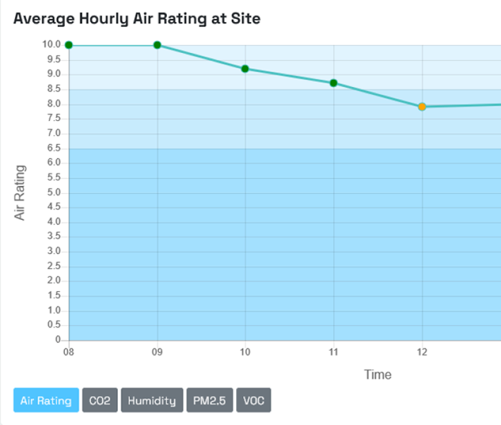

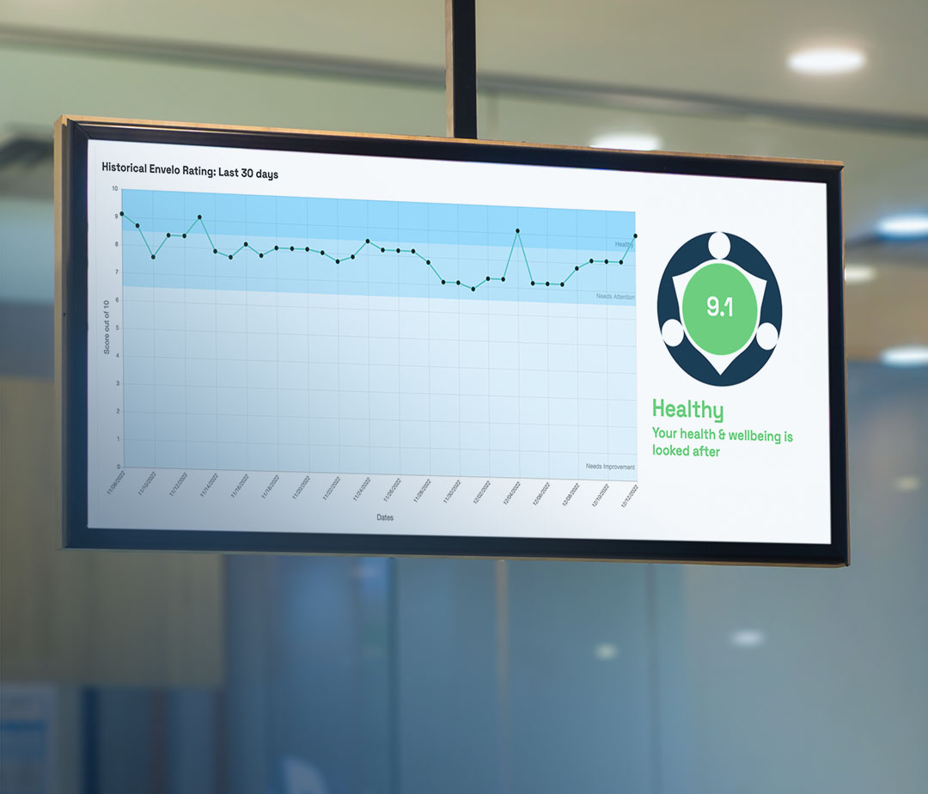
HOW TO: HEALTHY BUILDINGS
MONITOR
MANAGE
MESSAGE
Notes:
What does it take to have a healthy building? Well, there are multiple ways to approach this, from Passive methods (like installing filters), Semi-Active methods (augmenting those filters with air purifiers), and Active methods (monitoring and managing the air in your building spaces). We’re going to focus on the Active approach, which can be broken down into three categories: Monitor, Manage, and Message.
MONITOR
Step 1 is knowing. It all starts with having some way of monitoring the air quality. There are many good monitors out there, choose the best one for you. You may even have some in place already. But proper and efficient action CANNOT happen without monitoring.
MANAGE
What’s important to an active solution is what you do with that data once you have it. Some obvious examples:
-Tune-up your building (leak repairs, general maintenance, cleaning)
-Maximize outdoor air
-Upgrade Filters
-Switch to more energy efficient systems
But what if you could take that data and turn it into an action plan that directly benefits students and staff while reducing energy usage? By that, I mean automated workflows running in the background that direct energy for improved ventilation or purification only where and when it’s needed. If you’re able to collect all this data in real time, and tie those workflows into your building management system, you could significantly lower your energy costs, and I’ve got a couple of case studies that will illustrate that in a minute.
MESSAGE
You’ve spent all this money, whether it’s from ESSER funding, or whatever, to implement changes that hopefully have had an impact on air quality. It’s important to make those positive results known. I mentioned before how restaurants depend on customers knowing their places are safe and healthy. You folks in the private sector, wouldn’t it be beneficial to be able to convey that same sort of confidence to your customers and staff, when it comes to air quality and the health of your buildings? Wouldn’t it be good for those of you in K12 to be able to show the improvements you’ve made in classroom air quality to the public, to parents, to your school board? I’m talking about an easy-to-understand rating to show the health of your building spaces.

Slide 8
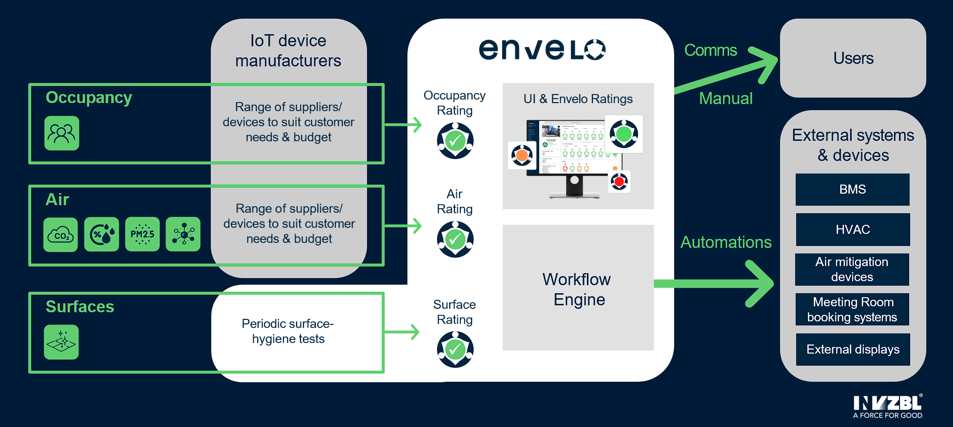
HOW TO DO IT
Notes:
So, we‘re talking about implementing automated workflows that run in the background. Here‘s a representation of what that looks like. As your air monitors relay data on air quality, the workflows automatically (through your building management system) increase or decrease ventilation as needed to affected areas. These workflows can also turn on any air purifiers you have in place, turn them up, or turn them off as needed, turn lights off in unoccupied rooms. As you can see here, we‘re looking at room occupancy as well as air quality, and we‘re also taking periodic hygiene readings of surfaces. Platform-agnostic sensors collect all this information, so that you‘re able to use off-the-shelf units, some of which you might already have in place. You don‘t want to be tied down to a proprietary system.
So, this whole software-based system is monitoring Occupancy, Air, and Surface health, then generating ratings for the spaces in your building. These ratings are displayed on a central dashboard for your maintenance/facilities team, so that they can see what’s happening in real time. As monitored areas change in rating, your team can immediately identify problem areas and address them, either directly or by assigning a workflow to do it automatically. You also have the *option* to display these ratings, on a kiosk screen for example, should you choose to.

Slide 9
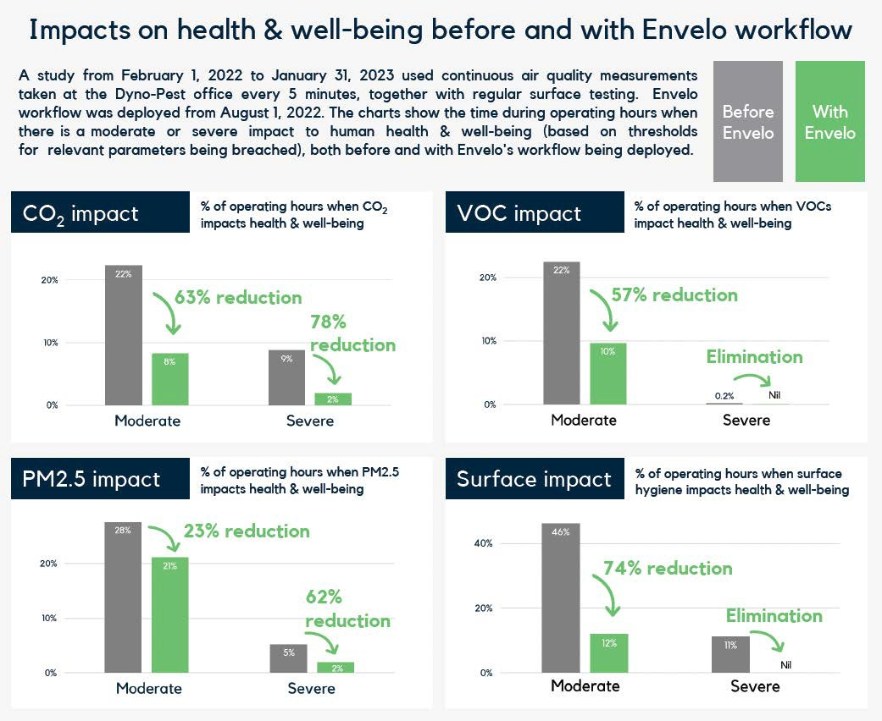
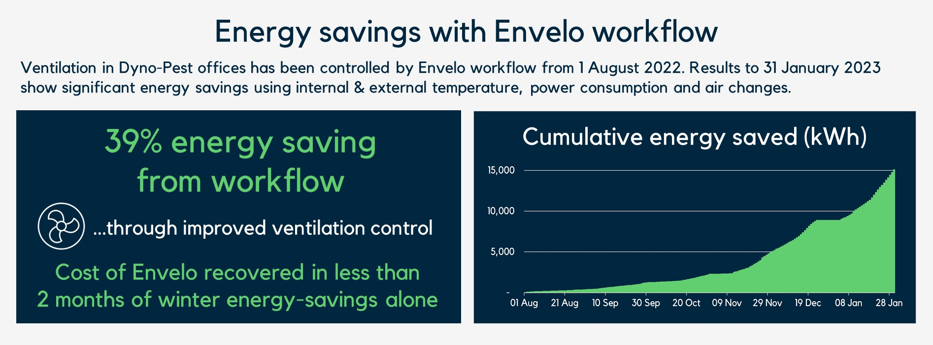
HEALTHY BUILDING Results & SAVINGS
Case Study #1
Notes:
Here is one of the case studies I mentioned earlier, from a company that implemented air monitoring with automated workflows. We‘re looking at massive reductions of instances where various airborne and surface pathogens directly impacted work hours and health & well being of staff. For example, the number of repors of moderate impacts of CO2 levels in this building dropped by 63%, and severe impacts dropped by 78% after going to this system. PM2.5 impacts were reduced by 23% and 62%. VOC and Surface moderate impacts were reduced by 57 and 74% respectively, and severe impacts for both of those were completely eliminated.
And impressively, by using those workflows to automate ventilation control, this company reduced their energy expenditures by 39%, and achieved a net positive ROI on the system within the first year it was deployed. As you can see in the chart, from August to January, they saved more than 15,000 kilowatt-hours.

Slide 10
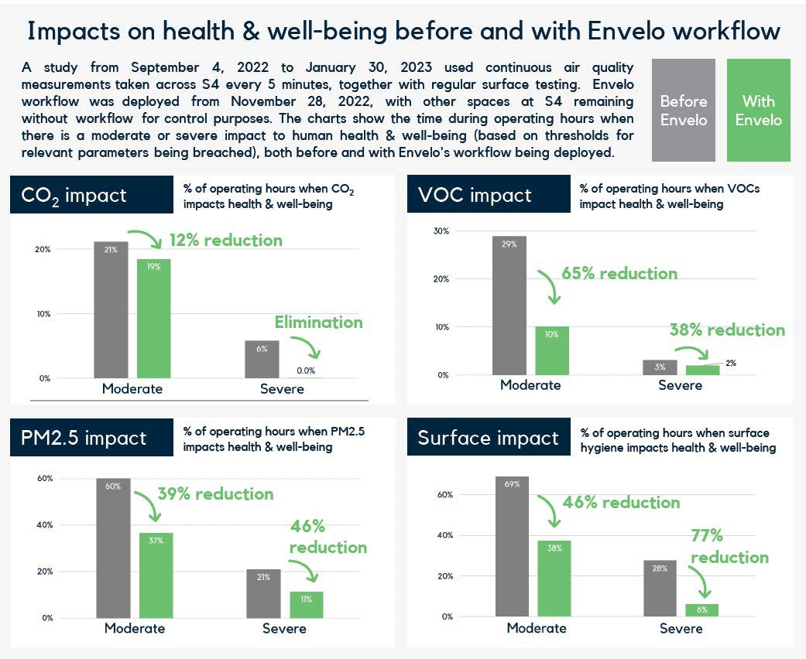
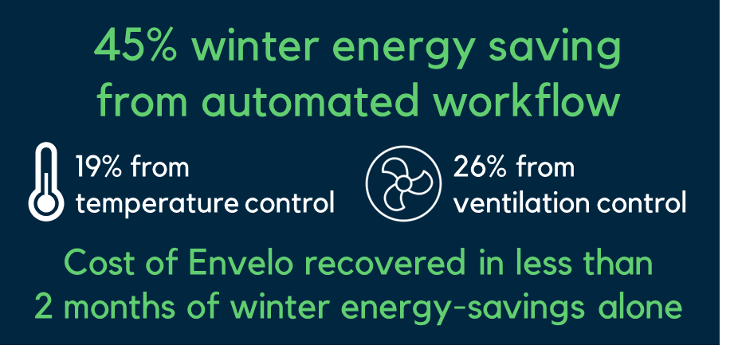
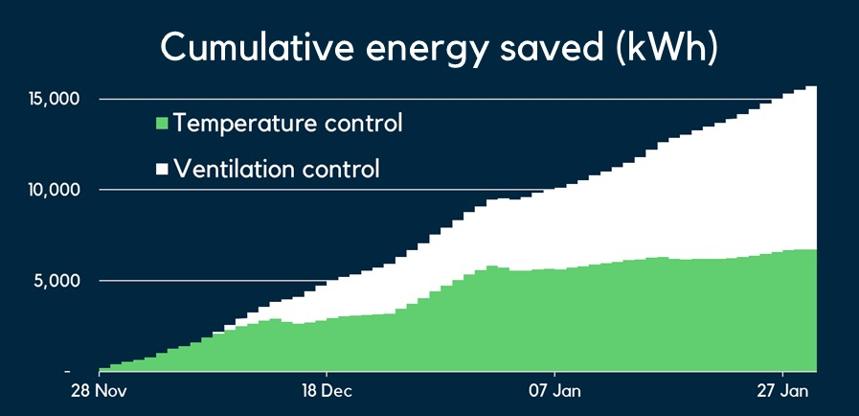
HEALTHY BUILDING Results & Savings
Case Study #2
Notes:
In our second case study, with a building of similar size, due to being able to tie in to both the ventilation and temperature controls, this company saw even MORE energy savings, and still enoyed dramatic health and wellbeing improvements, including total elimination of severe CO2 impacts, and heavy reductions in other areas. This company was able to drop their winter energy costs by 45% at the same time, and recovered their investment in just 2 months.

Slide 11
People are happier in a healthy building
“The results speak for themselves. With better health and well-being for our employees, and major reductions in energy use, many different indoor environments could benefit from a solution like this.”
Paul Dawson, Project Director, Laing O’Rourke
“It’s a practical solution that means we have reduced sick leave, cut back on energy use and reduced outdoor pollution coming into the office. Crucially, everybody feels happier and more productive. ”
Joanna Stolorz, Office Manager, Dyno-Pest

Slide 12

More Employee Comments
“It’s the right thing to do.”
“This should be done in every building.”
“The workflow makes it easy for us to keep the environment healthy.”

Slide 13
The results show that health, well-being, and energy efficiency can be optimized together. Take Your first step to a Healthy Building.

Slide 14
Thank you
Begin your #healthybuilding transformation:
https://invzbl.com/envelo
discover@invzbl.com

